Slide 1



TLIQ
HARDWARES
Business Insights 360
AV
CREATED BY
V.ARUN KUMAR

Slide 2
Agenda
TLIQ
HARDWARES
1
Company Details
About AtliQ Hardwares Company Details
Problem Statement
2
Understand the business challenges faced by AtliQ Hardware’s(Imaginary Company) and the need for data analytics.
3
Project Overview
Define the project's objectives, scope, and key data sets to be analyzed.
Peter Pandey's Notes
4
Gain insights into the junior data analyst observations and preliminary findings.
5
Dashboard Showcase
Explore interactive dashboards that visually represent key metrics and insights.

Slide 3
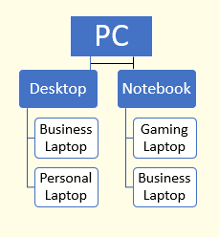
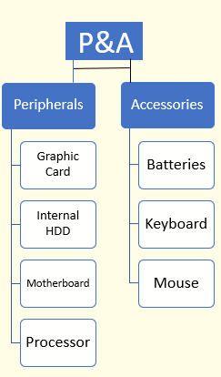
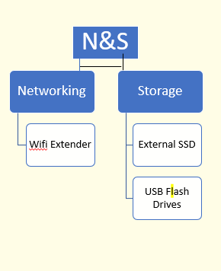
TLIQ
HARDWARES
COMPANY DETAILS
AtliQ Harwares(Imaginary Company) Is a Computer Hardware and Accessories Manufacture
FISCAL YEAR
ATLIQ’S PRODUCTS
FY_2020
SEPTEMBER(2019)-AUGUST(2020)
FY_2021
SEPTEMBER(2020)-AUGUST(2021)
FY_2022
SEPTEMBER(2021)-AUGUST(2022)

Slide 4

TLIQ
HARDWARES
Problem Statement
Business Growth
AtliQ Hardware, a consumer goods electronics company, is experiencing rapid growth but relies on excel files for data analytics, which is hindering effective insights and leading to potential losses.
Data Challenges
Excel files are inefficient for generating insights and managing large datasets, especially in a global company like AtliQ.
Latin America Loss
The company experienced a significant loss in the Latin American market, highlighting the need for improved data analysis to understand regional trends.
Data Analyst Role
As a Data Analyst I will take on the role of Junior Data Analyst Peter Pandey to examine data to uncover significate insights and explore themes.my Senior Data Analyst Tony Sharma ,I will use various analytical tools to concise presentation for Product Owner Nick Puri, who values strong storytelling

Slide 5

TLIQ
HARDWARES
Project Overview
1
Objective
Conduct a comprehensive analysis of AtliQ Hardware's data to identify key insights and improve business performance.
2
Focus
Analyze the data sets of fact_forecast_monthly, fact_sales_monthly, post_invoice_deduction, and pre_invoice_deduction.
3
Data Sets
Include detailed information about customer, market, product, freight cost, manufacturing cost, and gross price.
4
Data Corrections
Remove leading and trailing spaces, correct spelling errors, and eliminate duplicate data/names.

Slide 6

Peter Pandey's Notes
Peter Pandey, the junior data analyst, has begun his analysis of AtliQ's data, diligently investigating key metrics and potential insights. Peter is collaborating with Tony Sharma, his Senior Data Analyst, to present concise and compelling findings to Nick Puri, the Product Owner.

Slide 7
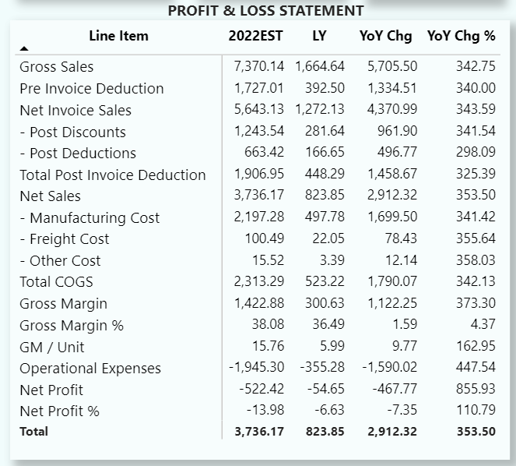
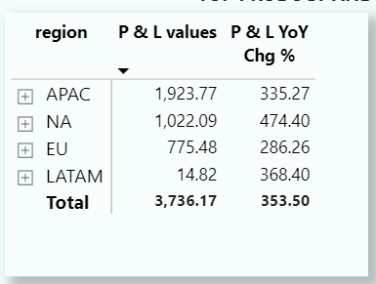
Economy View
Net Sales Increase
Compared to last year (2021), net sales have significantly increased by $2912M, indicating robust overall business performance.
APAC Region Performance
The APAC region leads with the highest net sales at
$1923M, highlighting the importance of this market for AtliQ.

Slide 8
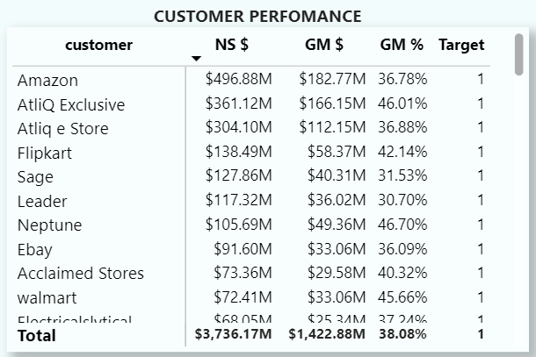
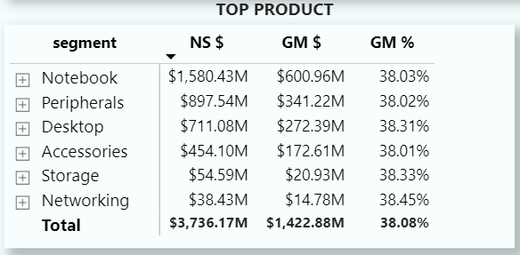
Sales View
Top Customer: Amazon
Top Product: Notebook
Amazon holds the highest net sales at $496.88M, demonstrating the importance of this major retailer to AtliQ's sales strategy.
Notebook products have generated the highest net sales at $1580.43M, highlighting the strong demand for this product category.

Slide 9
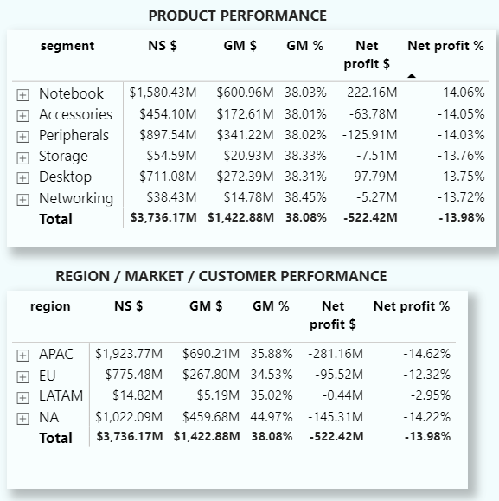
Marketing View
The Marketing View analyzes the effectiveness of AtliQ's marketing campaigns in driving sales and brand awareness. Key insights include the performance of different marketing channels, customer demographics, and overall campaign impact. This section also examines the relationship between marketing spending and sales revenue.

Slide 10
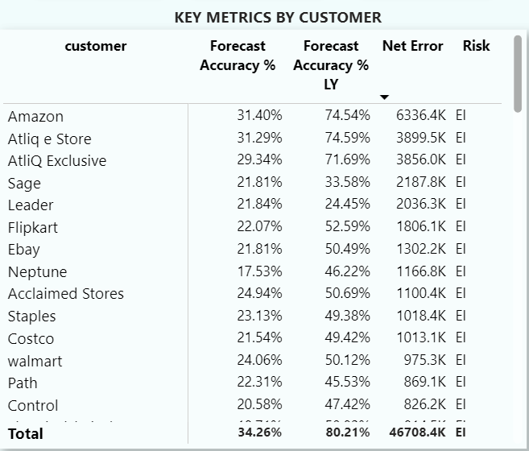
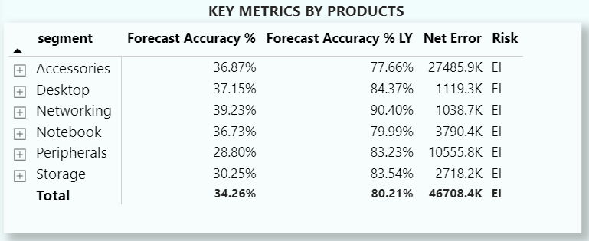
Supply Chain
Amazon has the highest forecast accuracy among the Customers, with a forecast accuracy % of 31.40%.
Networking have the highest forecast accuracy among the product segments, with a forecast accuracy of 39.23%.

Slide 11
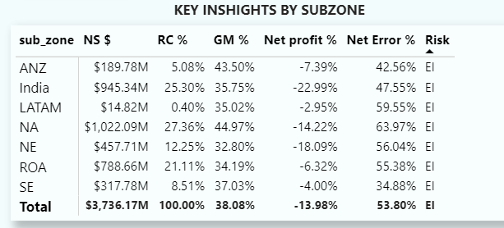




Executive View
Positive Growth
Strong Revenue
Product Optimization
International Expansion
Overall, AtliQ Hardware is demonstrating positive growth, indicating strong market performance and potential for continued success.
The company is generating significant revenue, highlighting a solid financial foundation and market appeal.
Focusing on product optimization and targeted marketing efforts can further enhance sales and profitability.
Exploring new international markets, especially in regions like APAC, can drive growth and expand the company's global reach.

Slide 12

DASBOARD

Slide 13

TLIQ
HARDWARES

